Slide 1
Machine Learning
Kyler & Carlos
4/12/24

Slide 2
Outline
What is machine learning
Basic structures of models
Types of learning
Common layers, weights/biases, & optimization
Model architectures
Physics Informed Neural Networks (PINNs)

Slide 3
Outline
What is machine learning
Basic structures of models
Types of learning
Common layers, weights/biases, & optimization
Model architectures
Physics Informed Neural Networks (PINNs)

Slide 4
What is Machine Learning?
IBM: “Machine learning (ML) is a branch of artificial intelligence (AI) and computer science that focuses on the using data and algorithms to enable AI to imitate the way that humans learn, gradually improving its accuracy.”
Consists of:
Decision process
Error function
Model optimization process
“Garbage in, garbage out”

Slide 5
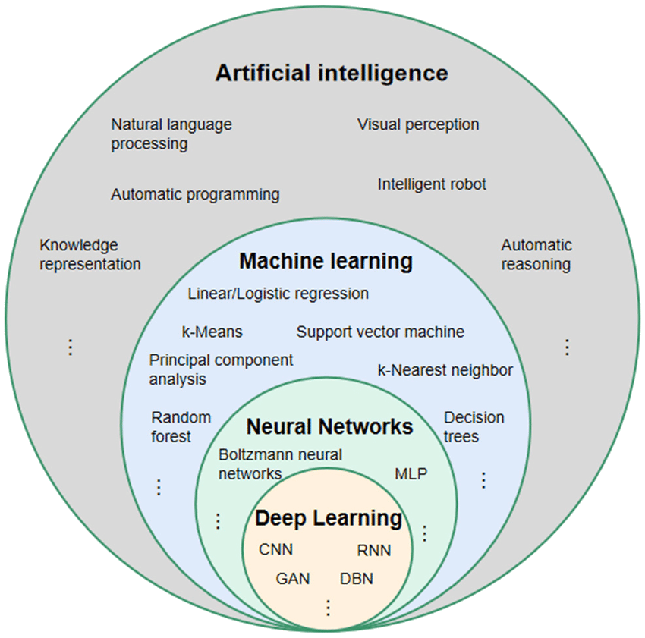
Classifications of Artificial Intelligence
Notes:
A neural network of more than three layers, including the inputs and the output, can be considered a deep-learning algorithm. That can be represented by the following diagram:

Slide 6
Brief History of Machine Learning
Least Squares Method (1805)
Bayes’ Theorem (1812)
Markov Chains (1913)
Artificial Neuron (1943)
First Neural Network (1951)
Perceptron (1957)
Nearest Neighbor (1967)
Neocognitron CNN (1980)
Recurrent Neural Networks (1982)
Boltzmann Machine (1985)
Support-Vector Machine (1995)
Random Forest (1995)
Notes:
https://en.wikipedia.org/wiki/Timeline_of_machine_learning

Slide 7
Outline
What is machine learning
Basic structures of models
Types of learning
Common layers, weights/biases, & optimization
Model architectures
Physics Informed Neural Networks (PINNs)

Slide 8
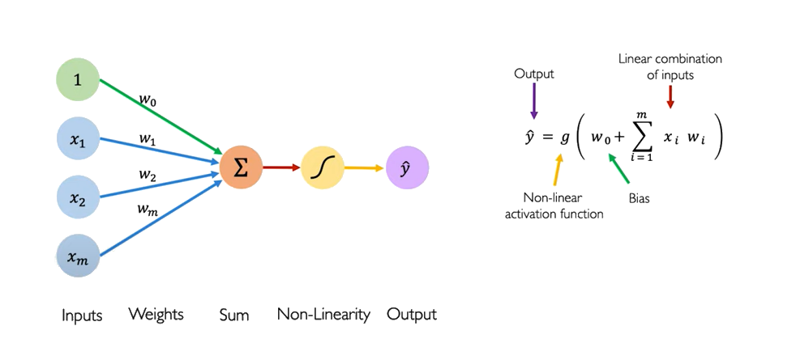
Perceptrons (1943/1957)
Basis of all fully connected layers

Slide 9
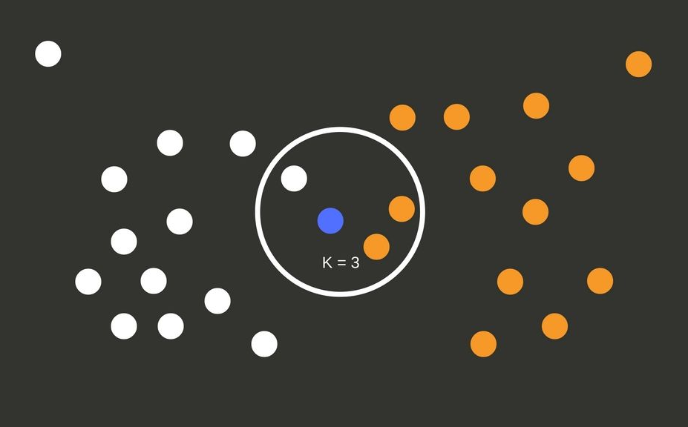
K-Nearest Neighbors (KNN, 1967)
Simple & fast
No real “training”
Best for ℝ³ or less

Slide 10
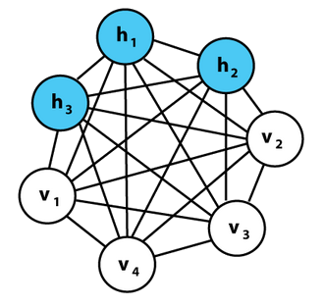
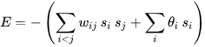
Boltzmann Machine (1985)
Each unit is restricted to a state {0,1}
Visible units are from the training set
Hidden units are randomly initialized
Minimize global energy
Weighted interactions and biases
Notes:
Used in dimensionality reduction/feature extraction

Slide 11
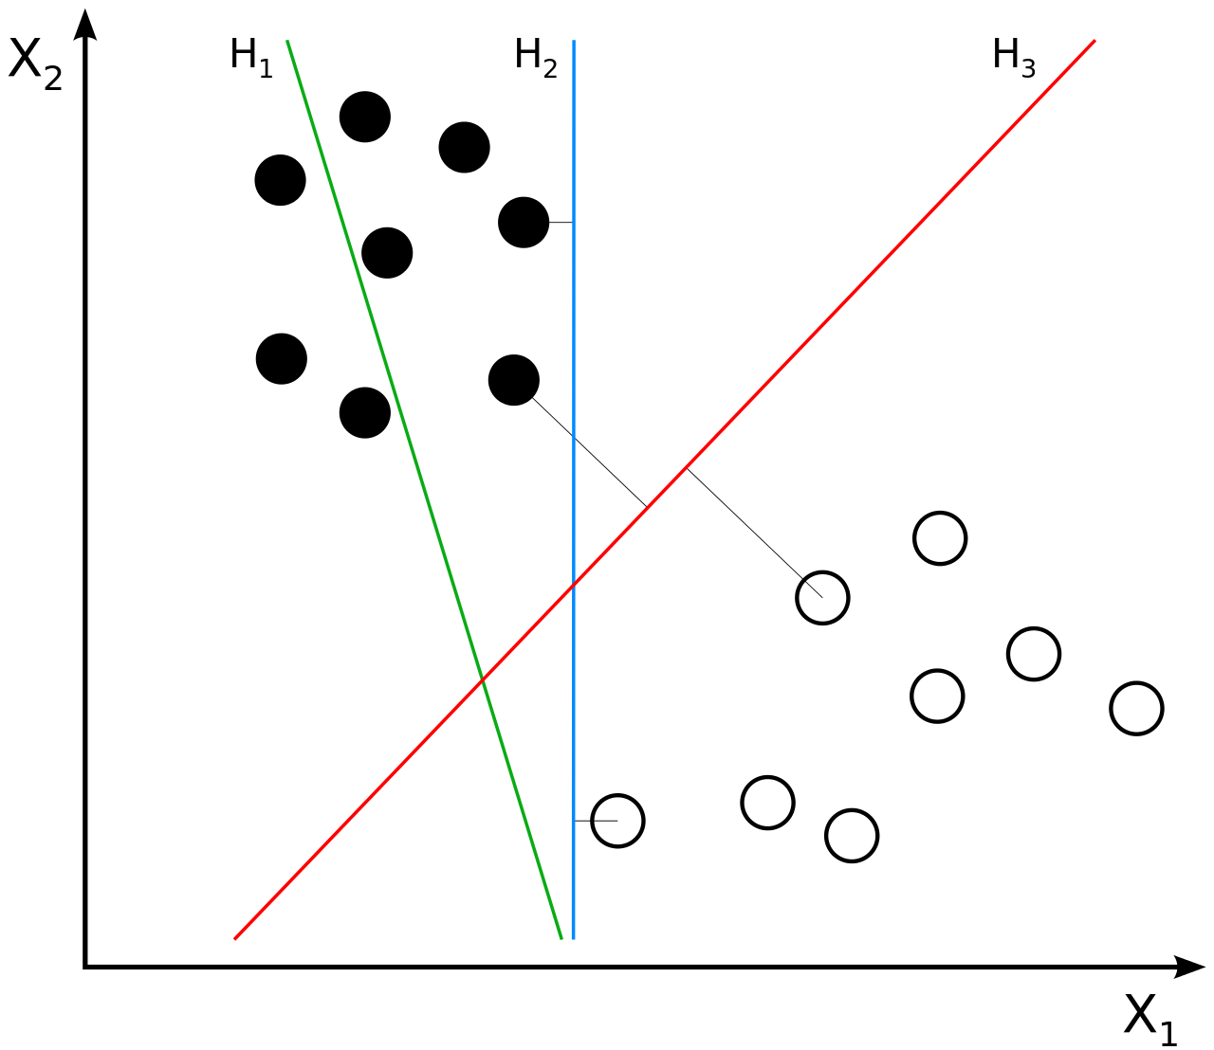
Support-Vector Machine (1995)
Maximize the margin between a hyperplane and the classified training data
H₃ in the figure is the maximum-margin hyperplane
Notes:
Used in classifiers

Slide 12
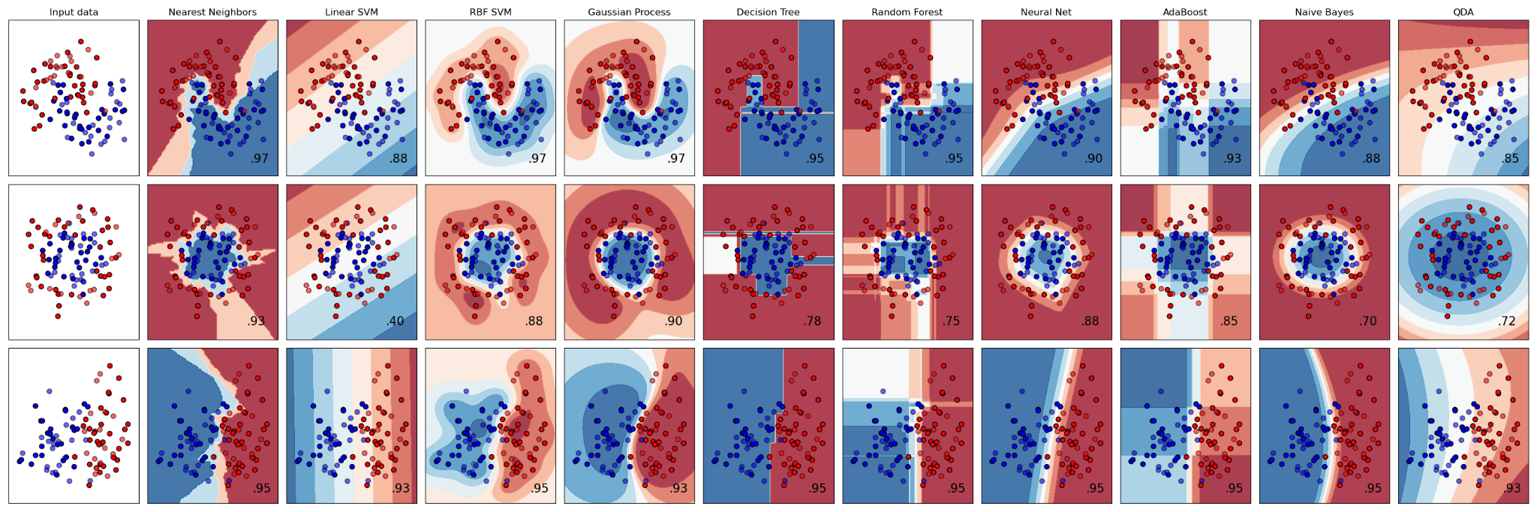
Basic Machine Learning Models
Linear Regression
Logistic Regression
K-Nearest Neighbors
Naive Bayes
Decision Trees
Random Forests
Notes:
https://scikit-learn.org/stable/auto_examples/classification/plot_classifier_comparison.html

Slide 13

Feed Forward Neural Networks
Most of our lab’s work
For independent data points
Simple to design/train
Can handle nonlinear data

Slide 14

Recurrent Neural Networks (RNNs)
For time series/sequence data
Contains “memory”
Vanishing gradient problem (also with deep feed forward)
Notes:
gradients used to compute the weight update may get very close to zero, preventing the network from learning new weights
as the error gradient is propagated backward through the network from the output layer to the input layer, it tends to decrease exponentially
Long short-term memory networks, Relu function, batch normalization, skip connections, etc.

Slide 15
Outline
What is machine learning
Basic structures of models
Types of learning
Common layers, weights/biases, & optimization
Model architectures
Physics Informed Neural Networks (PINNs)

Slide 16
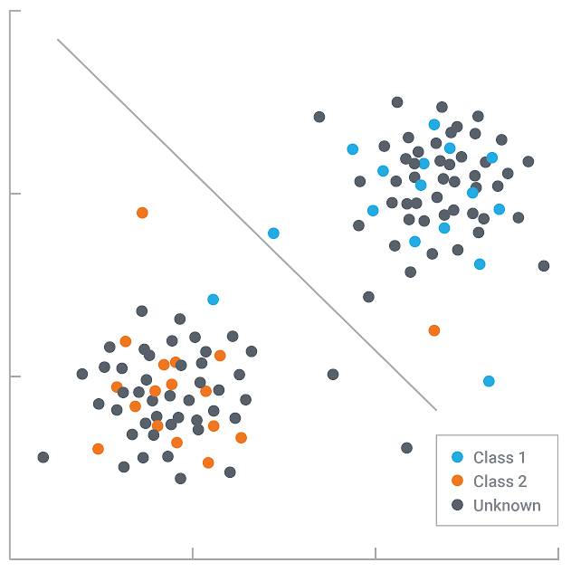
Supervised Learning
Virtually all of the models used in our lab
Labeled training sets
Useful for classification or regression
Models
Most neural networks (C/R)
Naive Bayes (C)
Linear/logistic regression (C/R)
Support vector machines (C/R)
K-nearest Neighbors (C/R)
Random forests (C/R)
Applications
Spam filtering
Image classification
Medical diagnosis

Slide 17
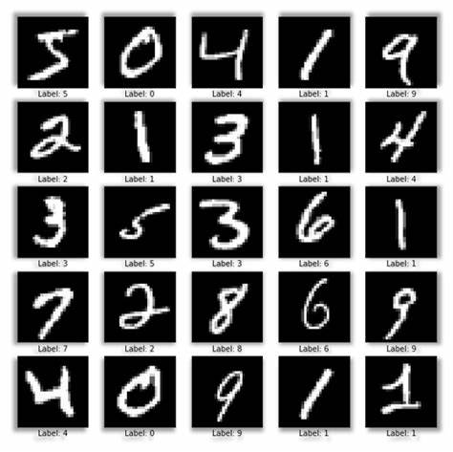
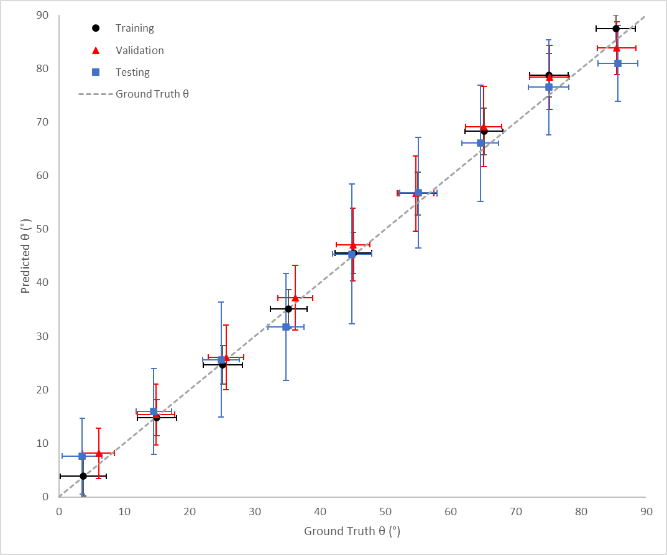
Classification
Regression
Each label predicts percent chance
Turns into a discrete output vector of 0/1
Outputs are continuous values

Slide 18
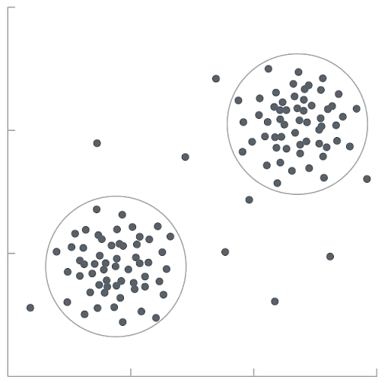
Unsupervised Learning
Unlabeled data, frequently no training
Useful for clustering, association, or dimensionality reduction
Extract latent space = features of interest
Models
K-means (C)
Apriori algorithms (A)
Autoencoders (DR)
Sequence to Sequence (Seq2Seq) models (DR)
Principal component analysis (DR)
Applications
Translation
Anomaly detection
Customer segmentation
Notes:
Association:
Discover “rules” that describe your data.
People who buy X also tend to buy Y

Slide 19
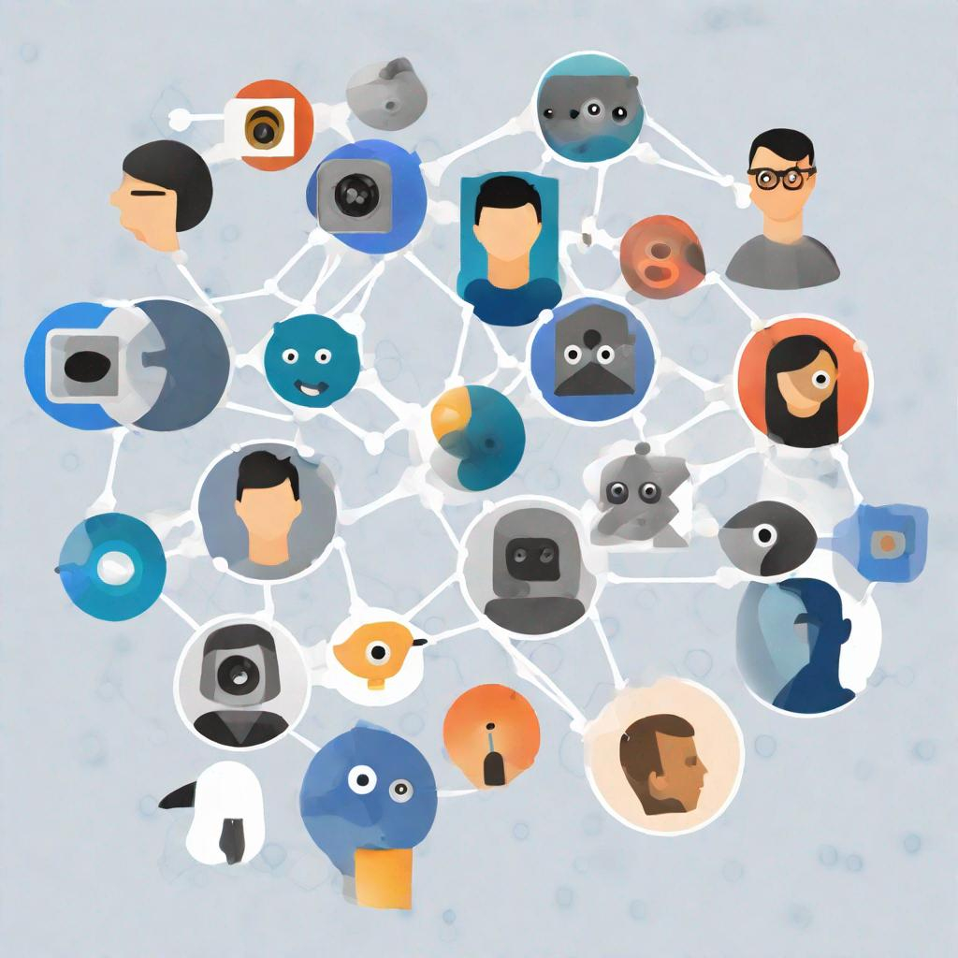
Self-Supervised Learning
Unsupervised learning on supervised tasks
Models generate implicit labels
Still has loss function
Models
Autoencoders (Dim’ Reduction)
Autoregression (Association)
BERT & GPT (NLP)
Generative Adversarial Networks (GANs)
Applications
Computer vision
Masked image reconstructions
Natural language processing (NLP)
Notes:
midjourney/stable diffusion
“Design an image to represent self-supervised learning such as autoencoders, GPTs, and GANs”

Slide 20
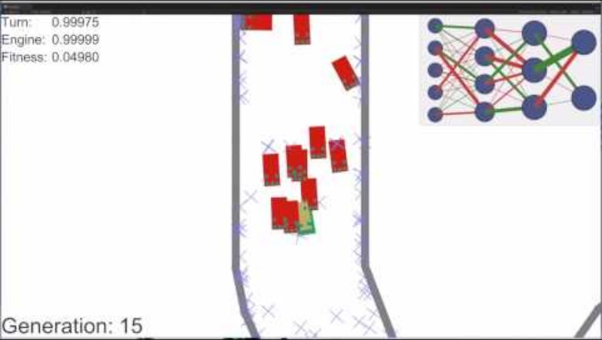
Reinforcement Learning
How intelligent agents should “take control”
Reward function
Models
Wayve cars
DeepBlue (1997)
AlphaGo (2016)
Applications
Robotics
Chatbots
Any large state spaces
Notes:
DeepBlue = chess
AlphaGo = Go

Slide 21
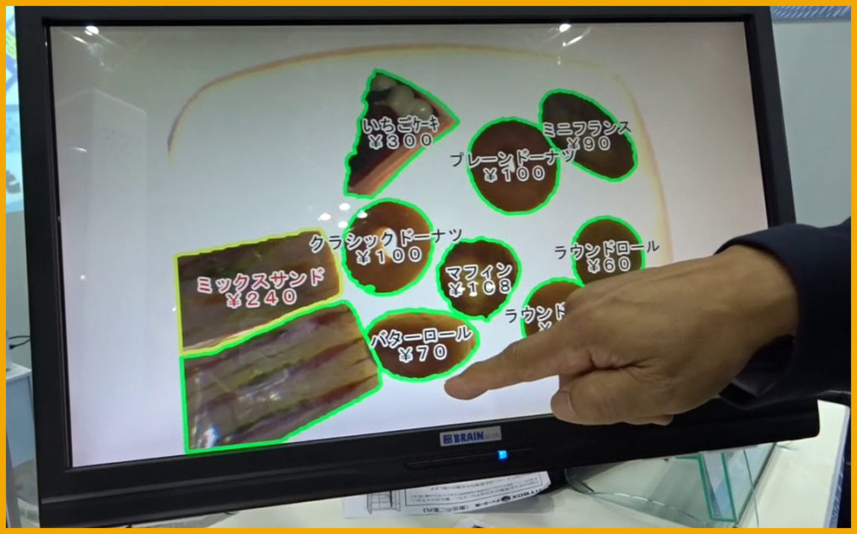
Transfer Learning
Pretrain on one task
Retrain or deploy on another
Improves generalization
Models
BakeryScan → Cyto-AiSCAN
ImageNet dataset
Inception
VGG
ResNet
Applications
Computer vision
Natural language processing
Notes:
3 conditions should be met
both learning tasks are similar
source and target datasets data distributions do not vary too greatly
a comparable model can be applied to both tasks

Slide 22
Outline
What is machine learning
Basic structures of models
Types of learning
Common layers, weights/biases, & optimization
Model architectures
Physics Informed Neural Networks (PINNs)

Slide 23
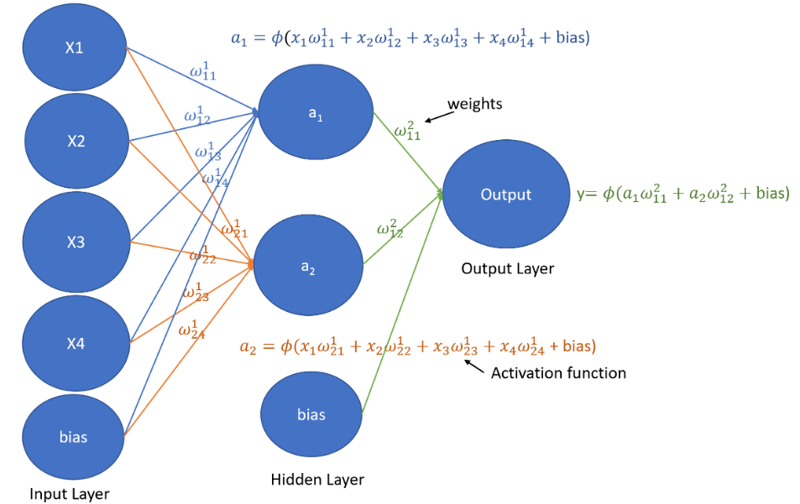
Weights and Biases
Weights: connections between neurons
Goal of minimizing loss function
Bias: enables shifting of the activation function
Scalar value added to the dot product before activation function
Notes:
Carlos

Slide 24
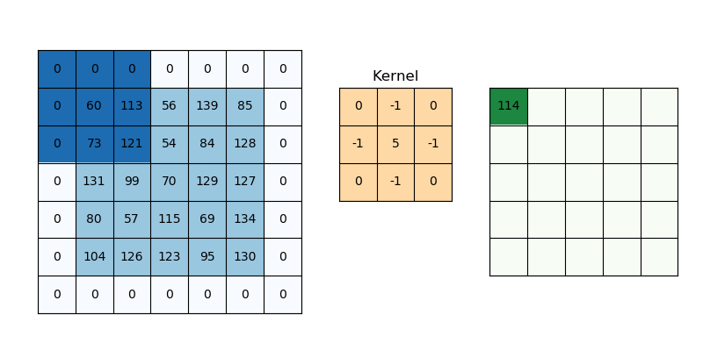
Convolutions
Sliding kernel extracts features:
Edges
Textures
Patterns
Notes:
Carlos

Slide 25
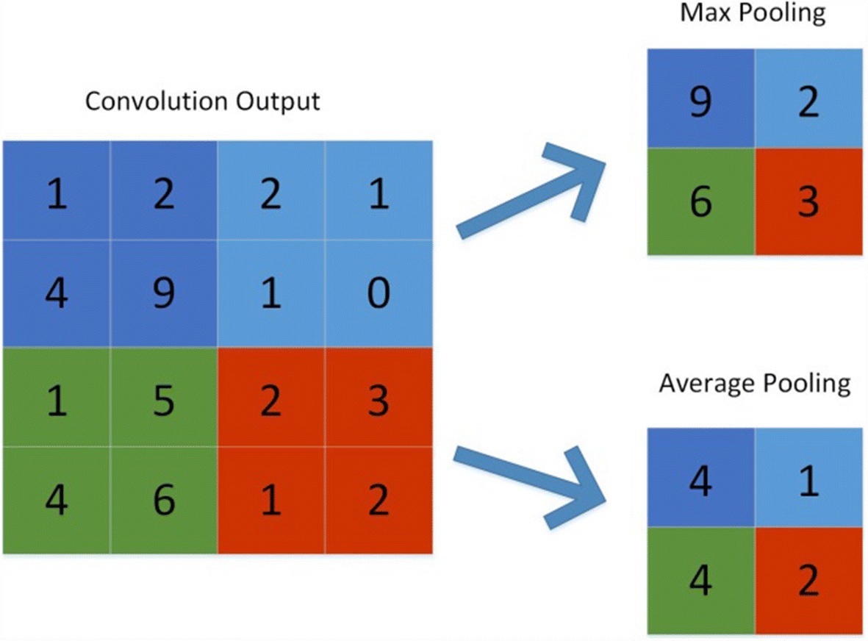
Pooling
Max Pooling: captures most significant element for feature map
Average pooling: captures broader context

Slide 26
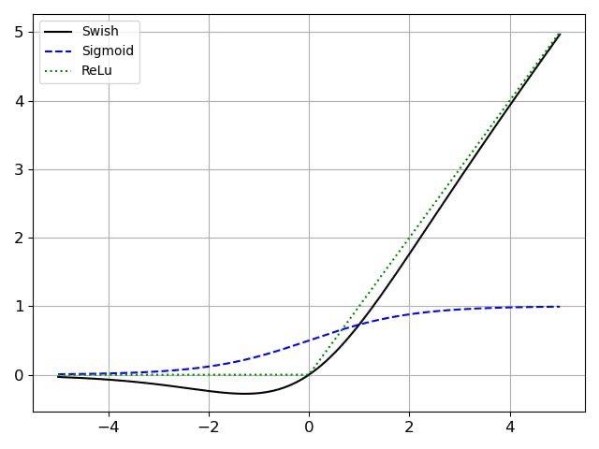
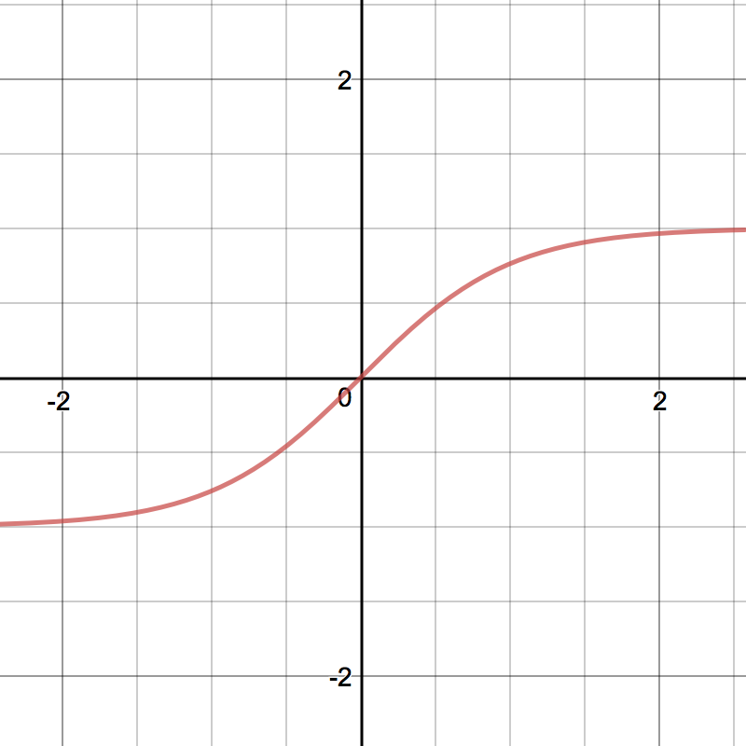
Activations
Relu
Sigmoid
Swish
Tanh
Used to introduce nonlinearity in the learning process
Notes:
Carlos - potentially add slides about how optimizers converge differently

Slide 27
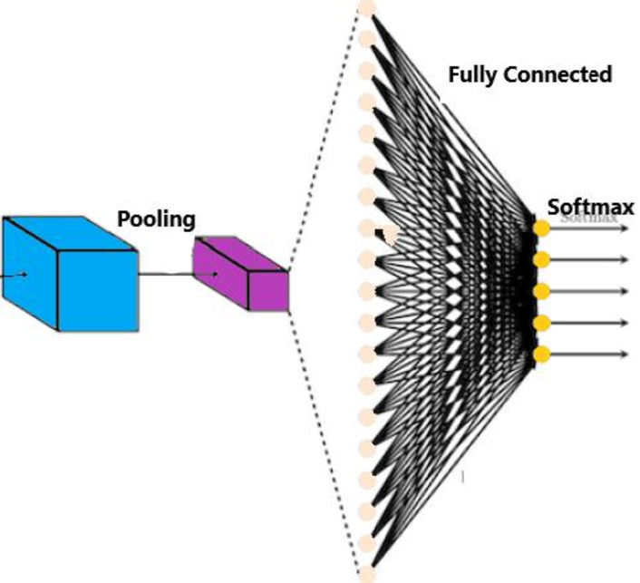
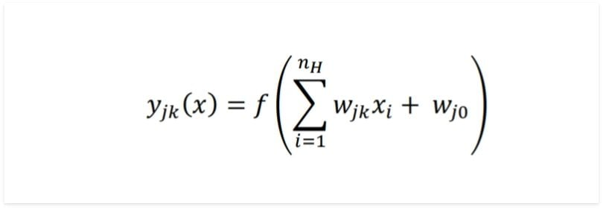
Fully Connected
Learn complex relationships: adjusting weights and biases during training
Adding dropout can reduce overfitting
Notes:
Carlos

Slide 28
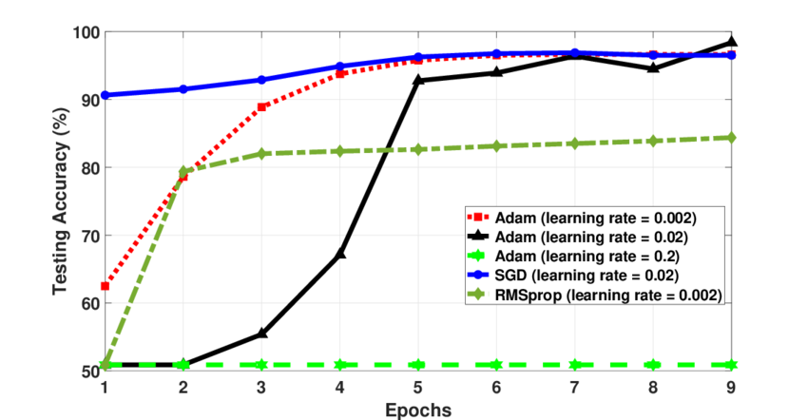
Learning Rates
How fast/slow model learns from data during training
High: oscillation/divergence
Low: stuck in local minima or slow convergence
Notes:
Graident descent image

Slide 29
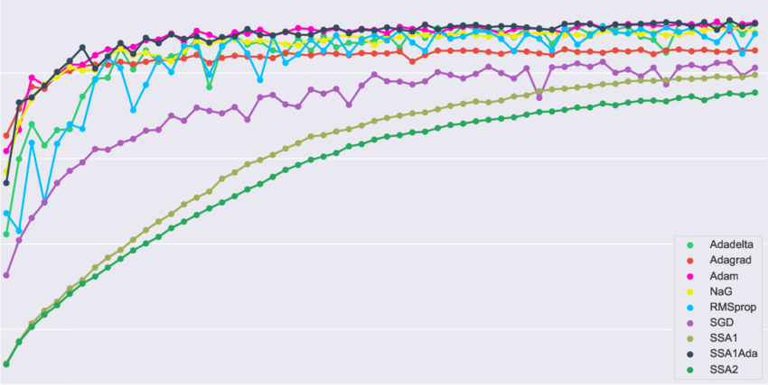
Optimizers
Minimize loss/cost function
Gradient Descent (manual tune learning rate)
Batch, Stochastic, Mini-batch
Adaptive (automatically tune learning rate)
Adam
RMSprop
Adagrad
RMSprop
Notes:
Common Optimizers:
Stochastic Gradient Descent (SGD): The basic form of gradient descent that updates weights using a small subset (mini-batch) of the training data.
Adam: An adaptive learning rate optimizer that combines ideas from both momentum and RMSProp. It adjusts the learning rate based on past gradients.
Adagrad: Adapts the learning rate for each parameter based on the historical gradients.
RMSProp: Root Mean Square Propagation, which also adapts the learning rate but with a moving average of squared gradients.
Momentum: Introduces momentum to accelerate convergence by considering past gradients.
Adadelta: An extension of Adagrad that addresses its limitations.

Slide 30

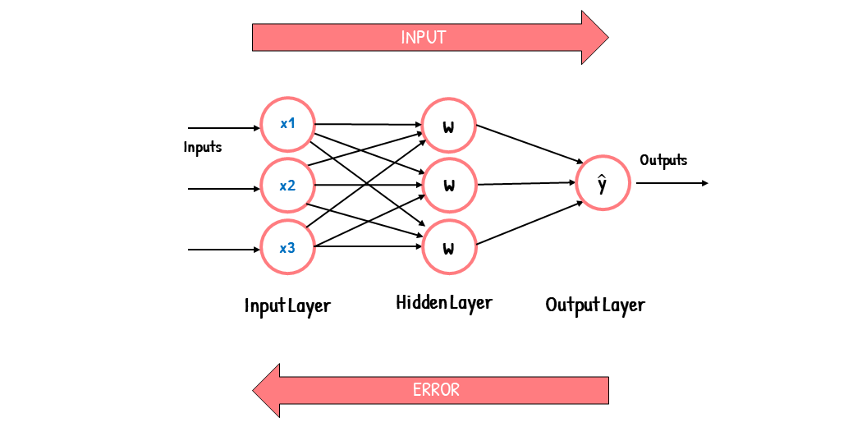
Backpropagation
Iteratively improves network output
Adjust weights to minimize cost function
Forward pass: input → output
Error calc:
Backward propagation: output → input, calculates gradient of error
Weight update: weights adjusted using error gradients

Slide 31
Outline
What is machine learning
Basic structures of models
Types of learning
Common layers, weights/biases, & optimization
Model architectures
Physics Informed Neural Networks (PINNs)

Slide 32
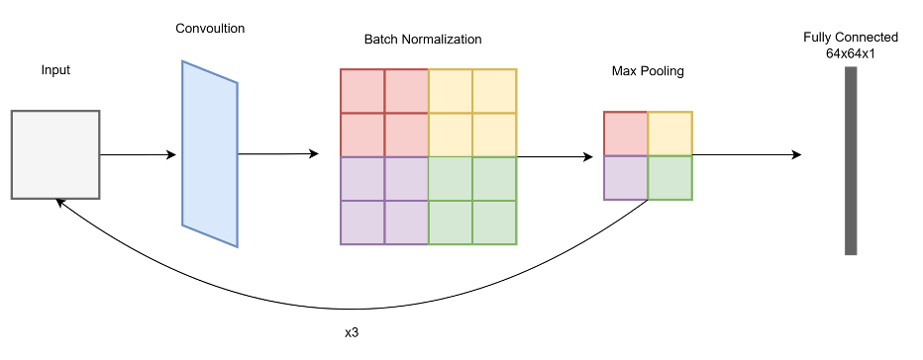
Convolutional Neural Networks (VGG16, AlexNet,...)
Notes:
Carlos

Slide 33
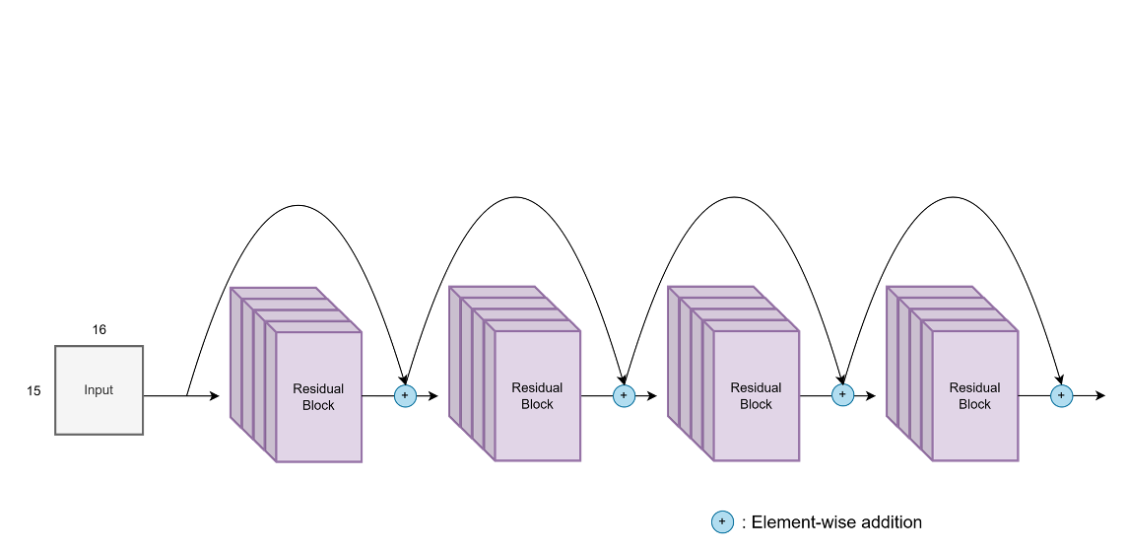
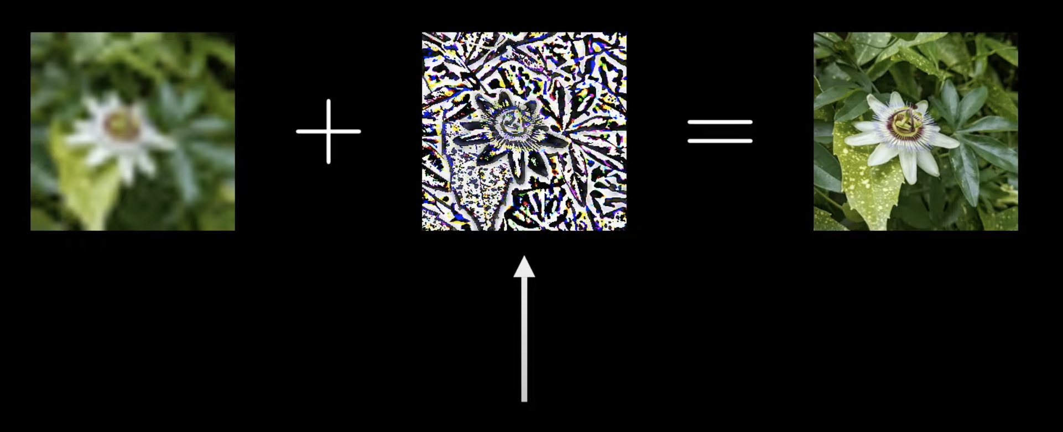
Residual Network (ResNet)
Notes:
Carlos

Slide 34
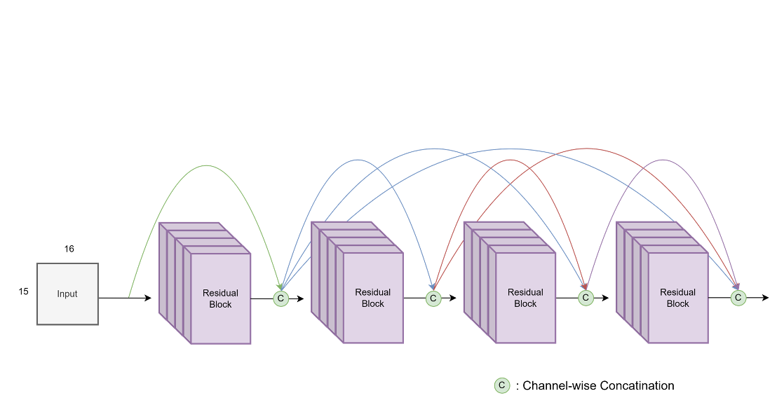
Dense Network (DenseNet)
Notes:
Carlos

Slide 35
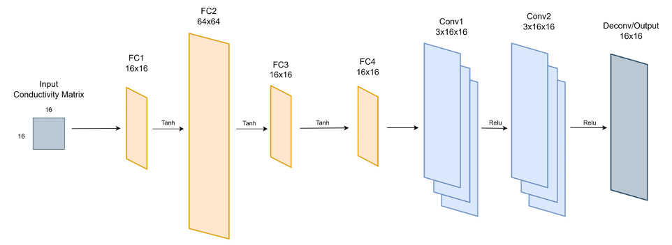
AUTOMAP
Notes:
Carlos

Slide 36
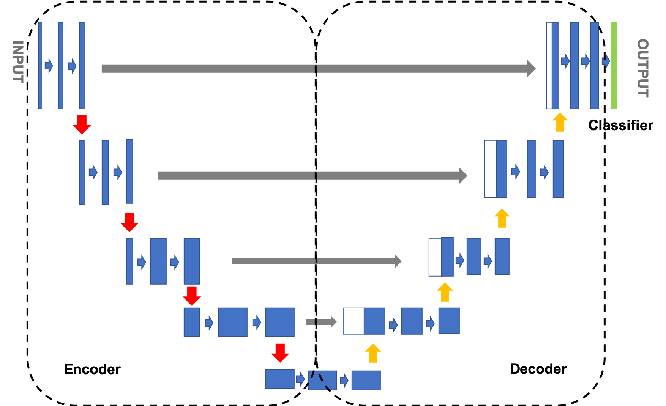
U-Net
Notes:
[X+L] -> Y

Slide 37
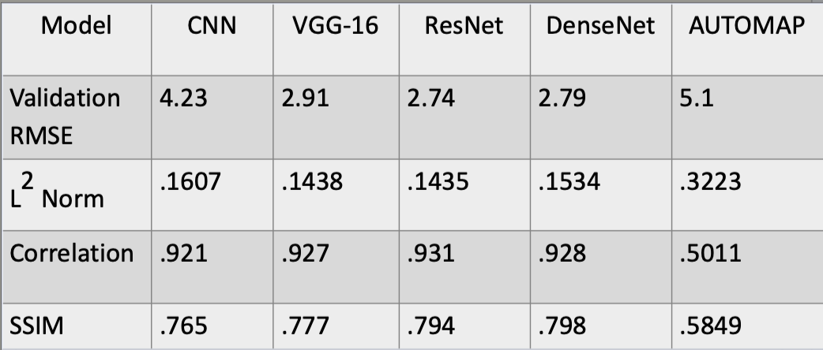
Carlos Results - Metrics

Slide 38
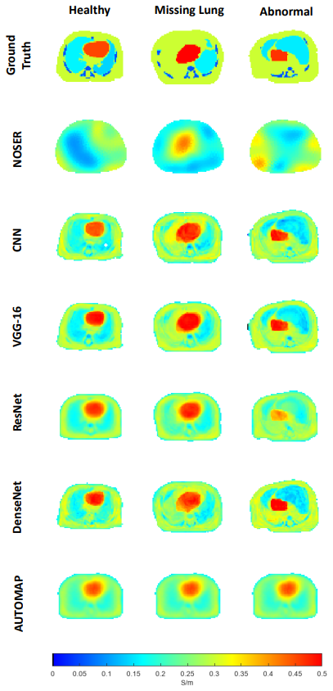
Carlos Results - Images

Slide 39
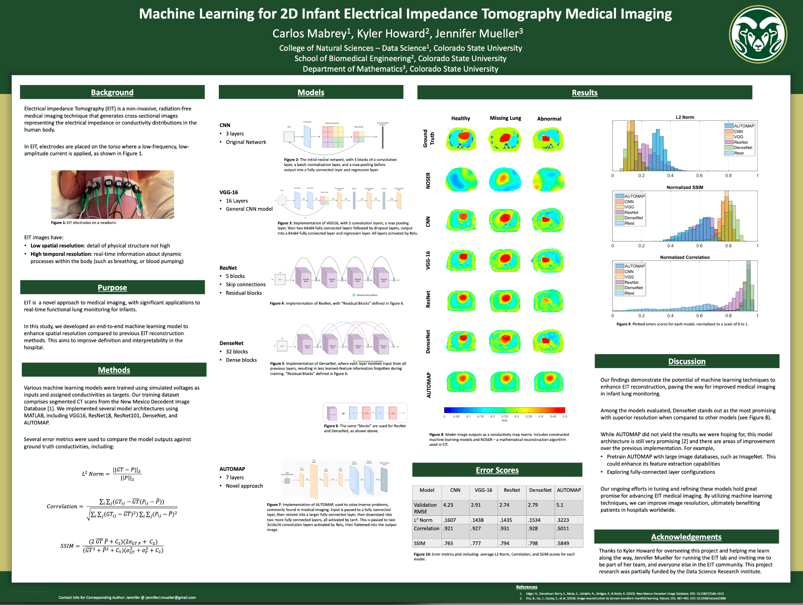
CURC
POSTER

Slide 40
Outline
What is machine learning
Basic structures of models
Types of learning
Common layers, weights/biases, & optimization
Model architectures
Physics Informed Neural Networks (PINNs)

Slide 41
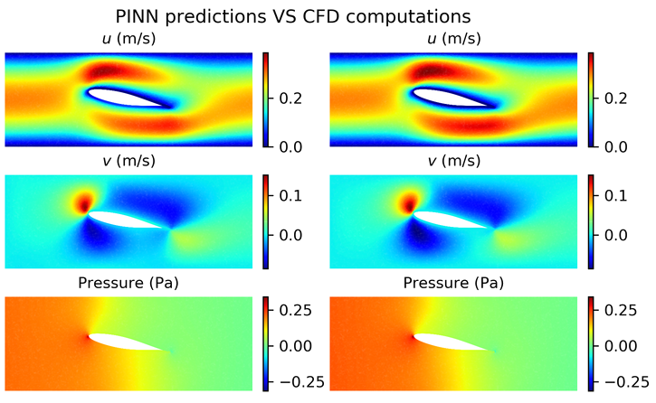
Physics Informed Neural Networks (PINNs)
First introduced in 2019
Replace the cost function with a PDE
Add boundary condition loss if you know it
Decreases necessary size of training set
Exploded in the realm of CFD
Can be an alternative for FEM

Slide 42
Why do PINNs work?
Universal function approximators
Easy to differentiate using automatic differentiation
Prior knowledge of physics acts as a regularization term

Slide 43
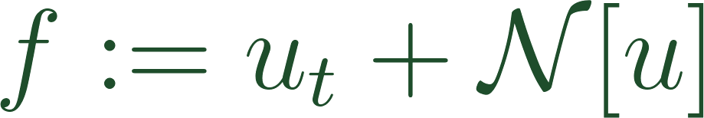
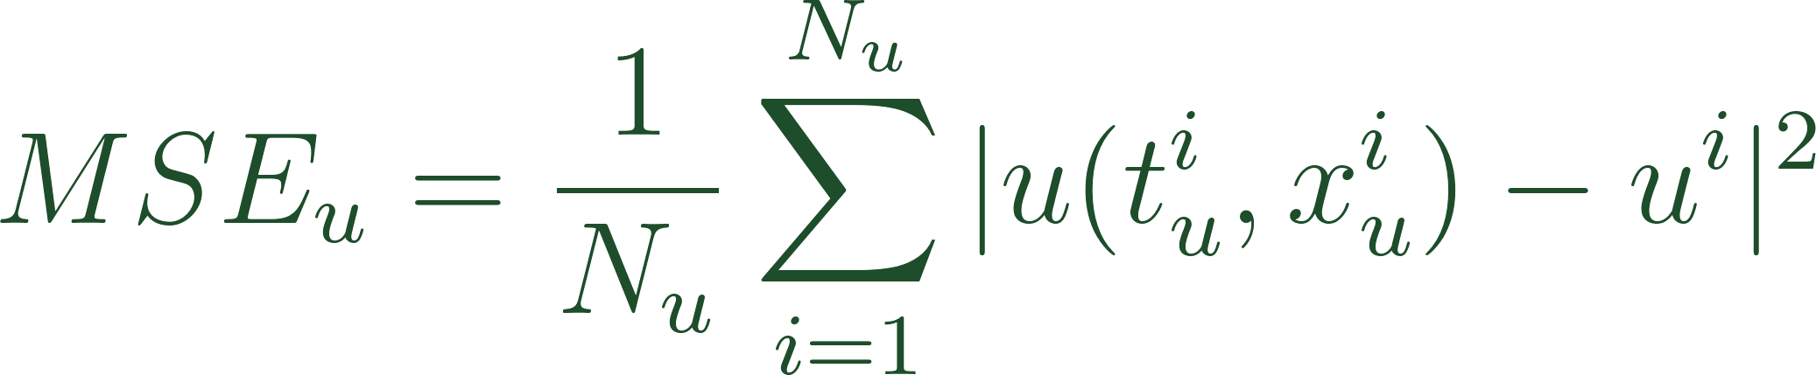
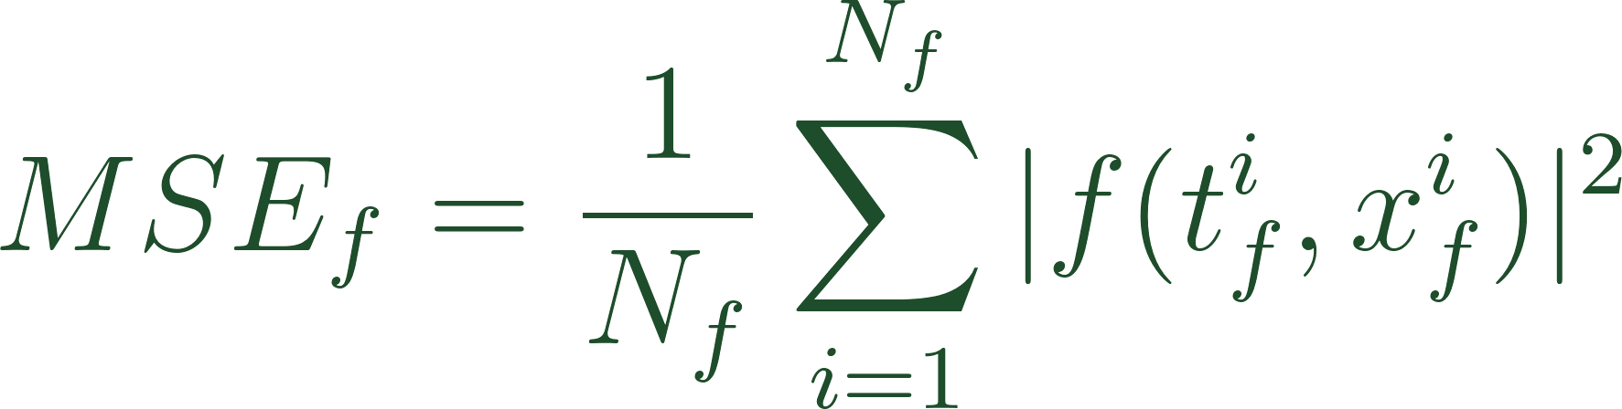
Original PINN Formulation
Notes:
nonlinear differential operator
t_u/x_u are initial/boundary training data
t_f/x_f are collocation points

Slide 44
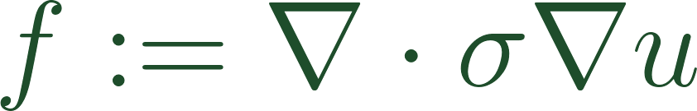
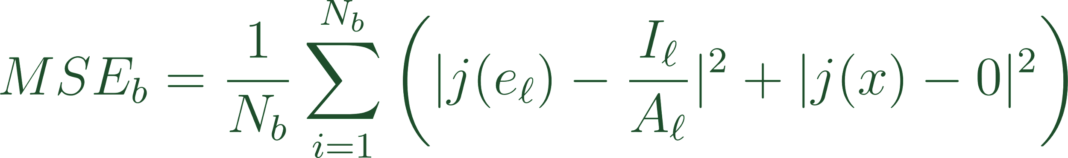
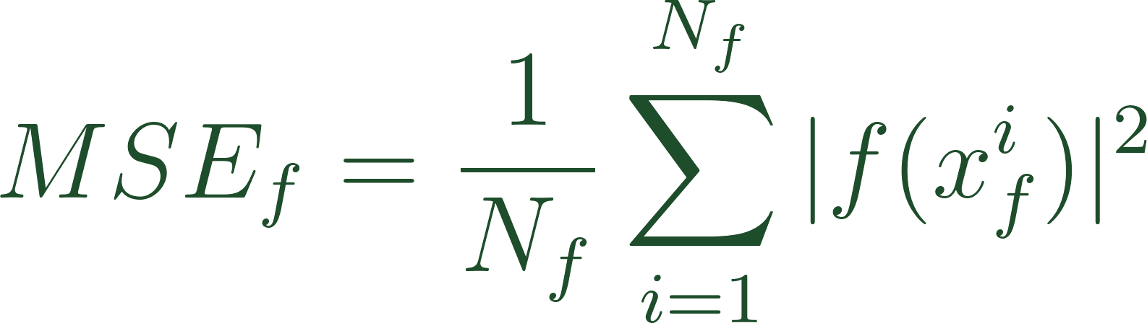
PINN Formulation for EIT Forward Problem

Slide 45
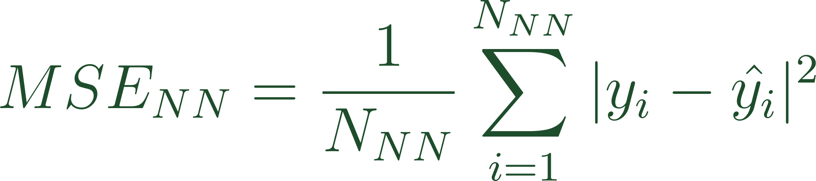
PINN Formulation for EIT Inverse Problem
Notes:
Ways we could set up where the variables come from
End to end
Input u, output sigma
Unet, output sigma from latent and u from main
Post process
Effectively do forward and post-process at same time. Get both u and sigma

Slide 46
Thank you

